Slide 1
Movie Data Analysis and predictions
Project Overview, Analysis, Findings and Conclusions
By – Deepshikha Singh
(DA41 Batch)

Slide 2
Problem Statement and objective
Problem Statement: The film industry lacks data-driven tools to predict movie success and uncover key factors influencing ratings and revenue.
Objective: To analyze movie data, predict success metrics, and extract key insights using machine learning and clustering techniques.

Slide 3
Technologies used
Python
MYSQL
Excel
Tableau
Data cleaning, preprocessing, EDA, visualization, ML modeling.
Stored cleaned data in a database.
Saved normalized data in CSV and XLSX format.
Created dashboards for capstone analysis.

Slide 4
Data preprocessing and observations
Data Cleaning
Outlier Handling
Feature Engineering
Sampling & Tests
ML Modeling
Standardized formats, handled missing values.
Used winsorization method for extreme values.
Created budget categories, language groups, and studio segments.
Applied T-Test, Z-Test, and random sampling.
Used LR, KNN & Random Forest for revenue and rating predictions.

Slide 5
OVERVIEW OF project
Focus Area 1
Box Office Performance
Focus Area 2
Focus Area 3
Director & Cast Influence
Focus Area 4
Language & Market Reach Analysis
Focus Area 5
Release Timing & Success Patterns
Focus Area 6
Production House Trends
Focus Area 7
Budget & Revenue Analysis
Focus Area 8
Focus Area 9
Viewer Demographics
Focus Area 10
Revenue Predictions
Genre Analysis
Audience and Critics Analysis

Slide 6
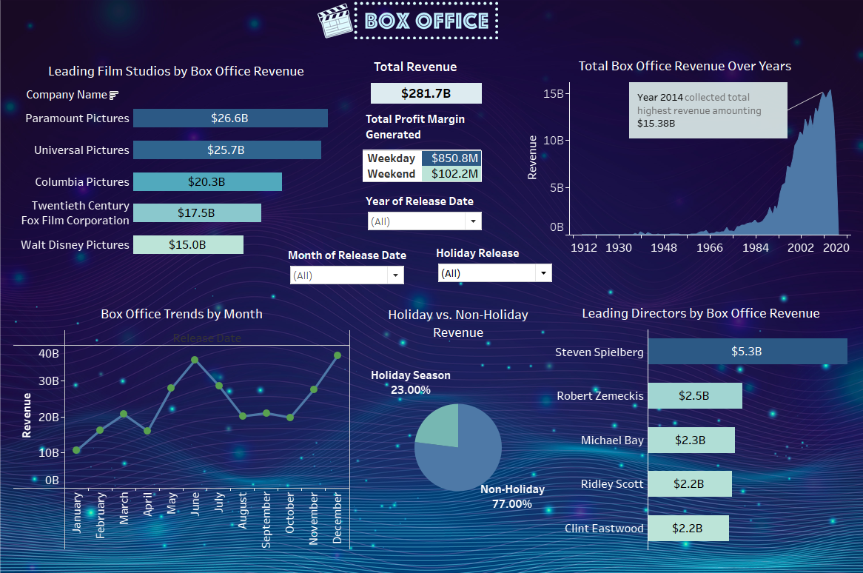
1. BOX OFFICE PERFORMANCE analysis

Slide 7
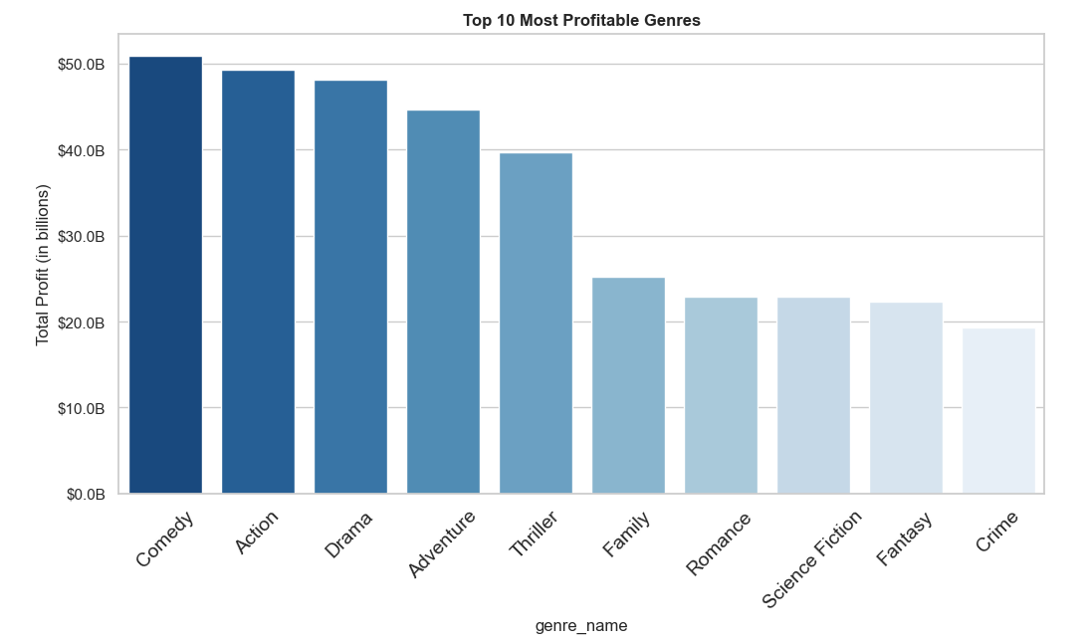
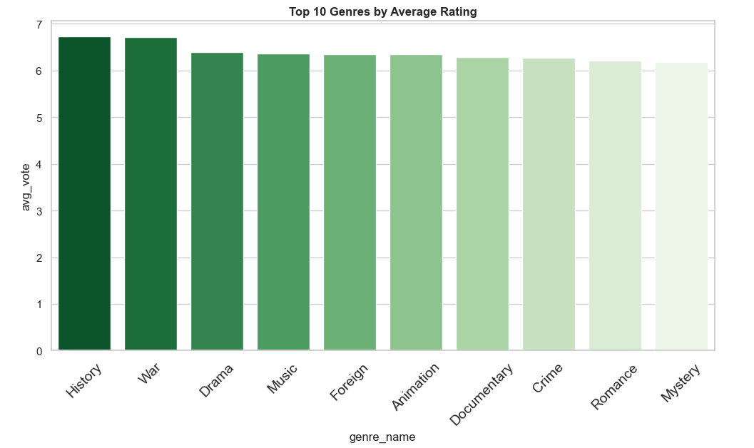
2. GENRE analysis
Identify the most profitable movie genres.
Are profitable genres also rate highly?
Interpretation:
Drama earns big despite lower budgets.
Comedy, Action, Drama lead in total profit.
Interpretation:
Drama has top audience rating, solid profit.
High profits don’t mean high ratings.

Slide 8
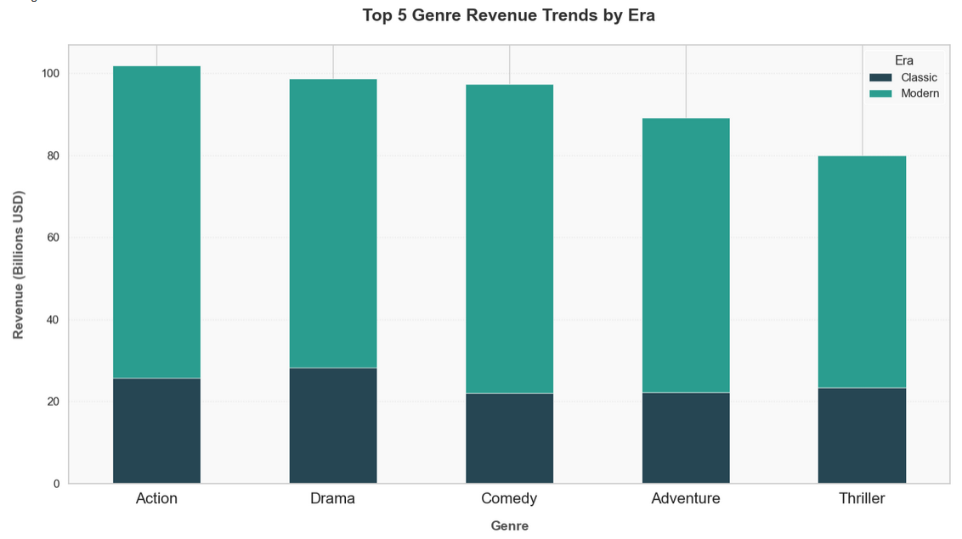
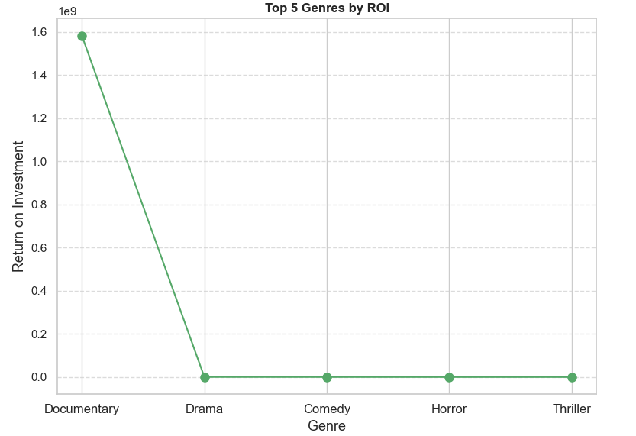
2. GENRE analysis
Compare genre success: modern vs. classic eras.
Determine genres with highest return on investment.
Modern films lead revenue in all top genres.
Action and Drama earn the highest overall revenue.
Interpretation:
Interpretation:
Horror yields big returns from low-cost productions.
Documentaries win with tiny budgets, massive ROI.

Slide 9
3. Director and cast influence
Identify directors who consistently drive high revenue
Steven Spielberg leads with $5.3B across 27 films — more than double any other director.
Evaluate directors based on average profit per film
Joseph Kosinski delivers the highest profit per movie, averaging $139.6M.
Assess actors with the highest reach and impact
Vincent D’Onofrio tops with 223 movies, $8.66B revenue, working with 190 unique directors.
Evaluate A-list actors’ influence on success
A-list actors earn avg. $80.6M per movie and score 6.03 ratings.
Analyze how directorial experience affects outcomes
Experienced directors like Steven Spielberg bring 3.5× more revenue and higher ratings (6.27 vs 5.69).

Slide 10
4. Language and market reach analysis
Identify languages driving the highest movie revenue
Japanese and English films stand out for top average earnings.
Compare English vs. Non-English movie performance
English films earn 3× more, though Japanese and Chinese lead among non-English titles.
Evaluate genre trends in non-English markets
Fantasy and Adventure genres bring in the most revenue abroad.

Slide 11
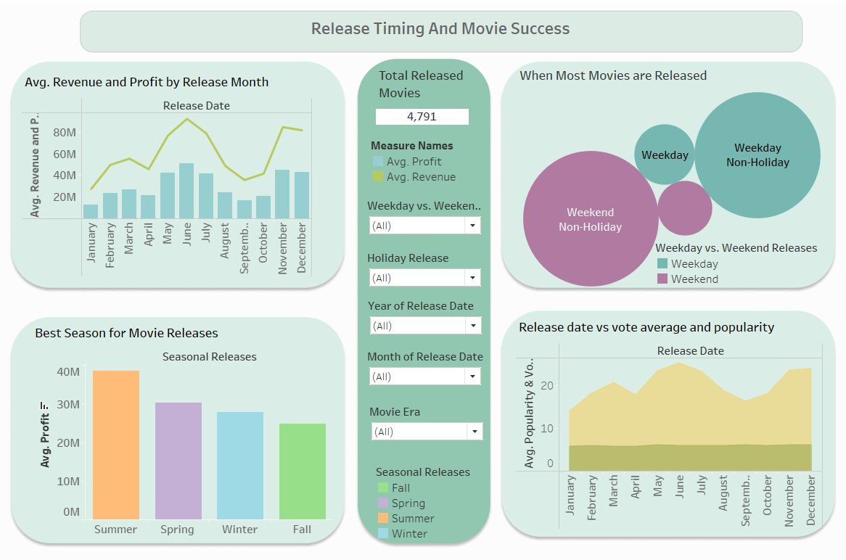
5. Release Timing ANalysis

Slide 12
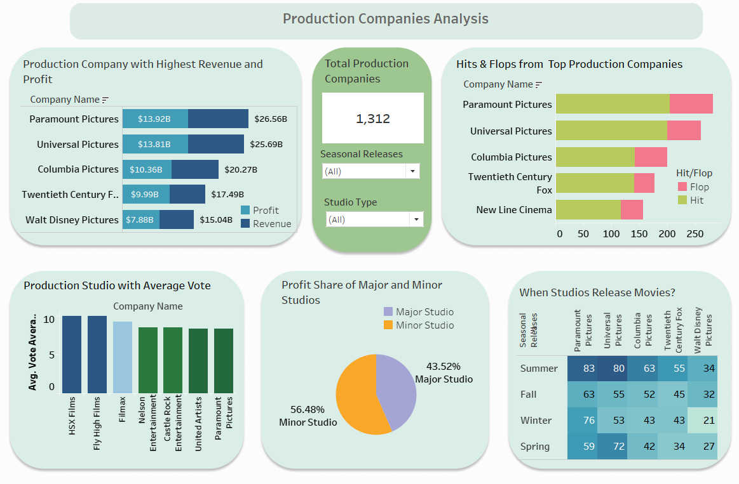
6. PRODUCTION HOUSE TRENDS

Slide 13
7. Budget and revenue ANALYSIS
Do High-Budget Movies Have Higher ROI?
Do Major studios outperform Minor Studios?
Z-Statistic | -2.659
P-Value | 0.9961
Conclusion: | No significant evidence that high-budget movies have higher ROI.
T-Statistic | 3.0553
P-Value | 0.0018
Conclusion: | Major studios significantly outperform Indie studios in profit.
Interpretation: High-budget movies do not guarantee better ROI.
Interpretation: Reinforcing the advantages of established production houses in financial success.

Slide 14
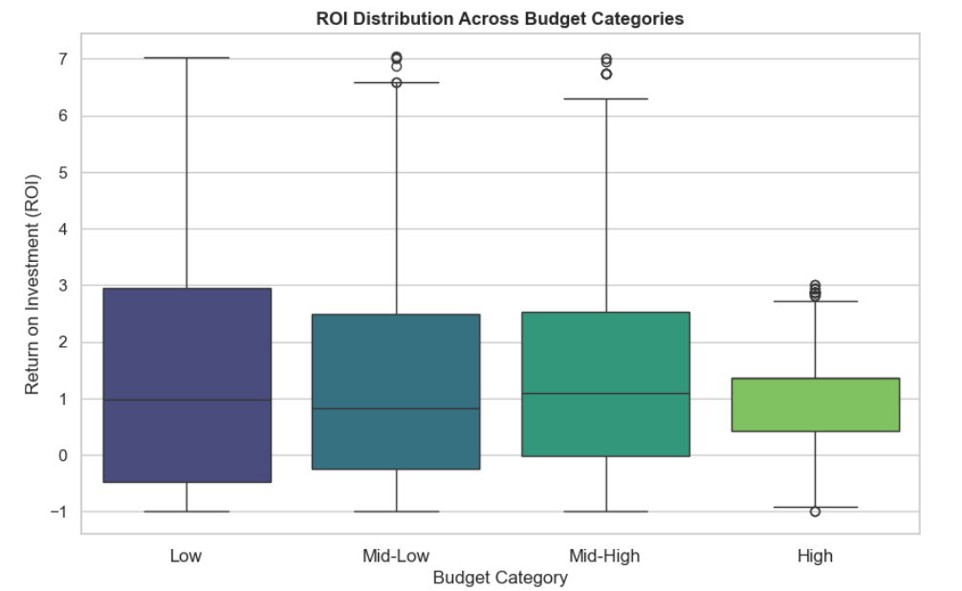
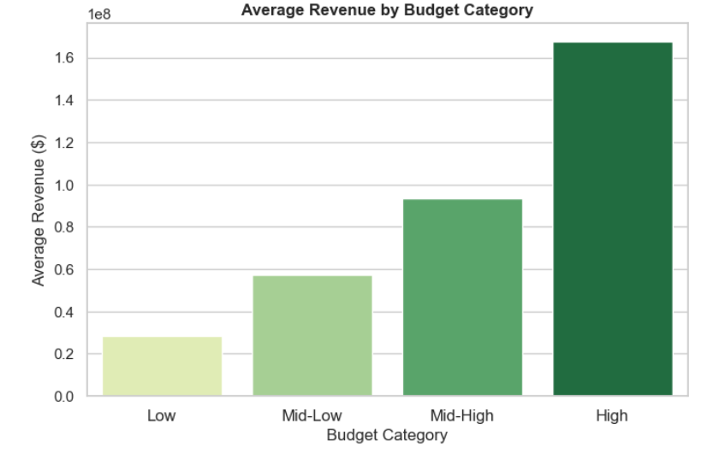
7. Budget and revenue ANALYSIS
To identify the most profitable budget category based on ROI
To evaluate how budget levels influence overall revenue generation
Interpretation: Low-budget films yield the highest ROI on average
Interpretation: Higher budgets drive significantly more total revenue

Slide 15
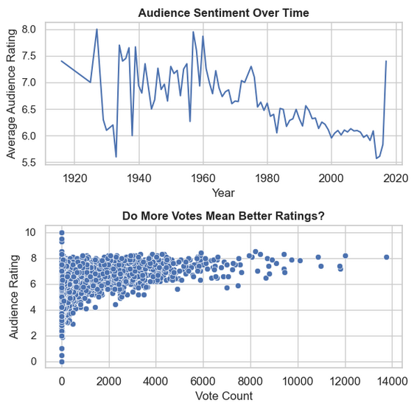
8. Audience Critic ANALYSIS
Analyze audience sentiment trends over time
Examine the relationship between vote count and ratings
Higher vote counts generally mean better ratings, but some low-rated films still get high votes.
Ratings declined post-1960, stabilizing around 6.0. Older films show more fluctuations.

Slide 16
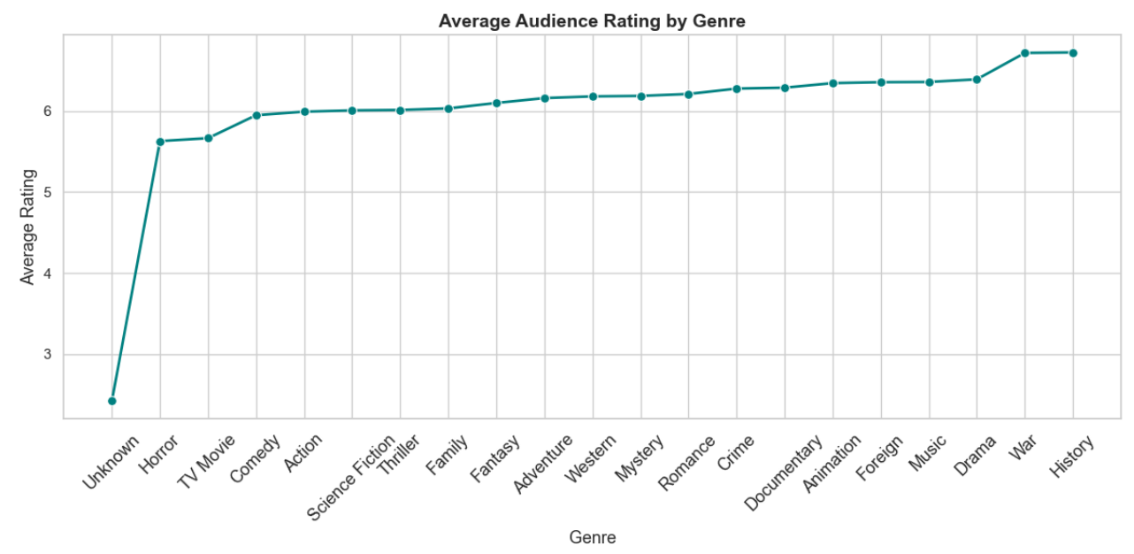
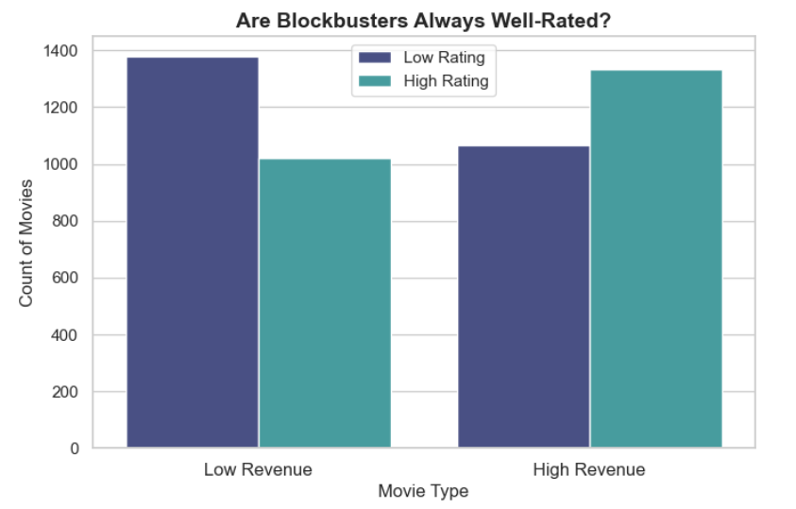
8. Audience Critic ANALYSIS
Identify the most well-received movie genres.
History, War, and Drama have the highest audience ratings.
Analyze the relationship between revenue and ratings.
High-revenue movies tend to receive more positive ratings.
Not all blockbusters are well-rated, but they perform better overall.
Genres like Animation and Crime also perform well.

Slide 17
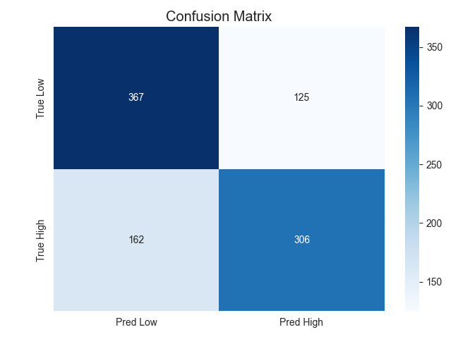
8. Audience Critic ANALYSIS
Predict Movie Rating Categories Accurately
Strong at detecting low-rated movies (75% recall, 367 true lows).
Balanced precision (69-71%) ensures consistent classification.
Fair overall accuracy (70%), outperforming random guessing.
Detects high-rated films with reasonable success (306 true highs).

Slide 18
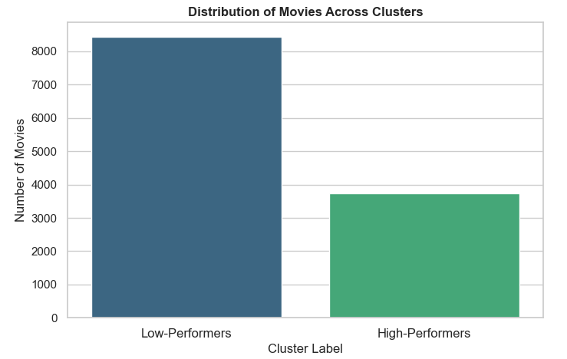
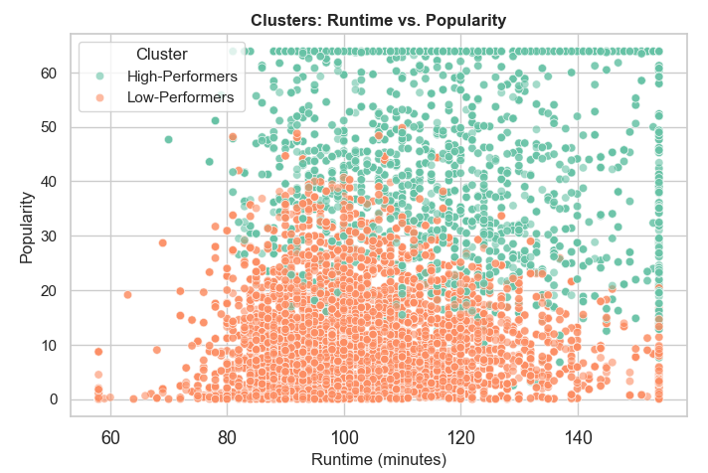
9. Viewer demographics- cluster ANALYSIS
To evaluate movie clusters by performance level
To identify traits within high-performance clusters
Interpretation: Majority of clustered movies are low-performers (8400 vs. 3700)
Interpretation: High performers: popular, 80–140 min runtime range

Slide 19
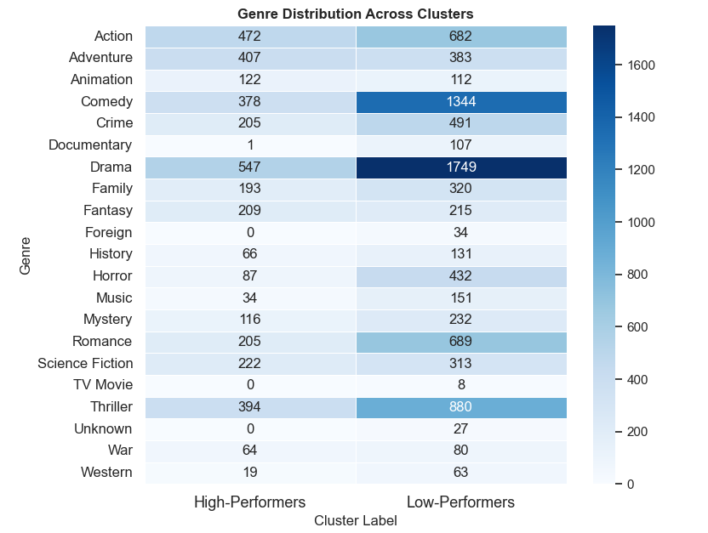
9. Viewer demographics- cluster ANALYSIS
To identify genre-based success patterns using cluster analysis.
High-performing movies are often action, adventure, and sci-f.
While low performers lean toward drama, horror, and romance.
Comedy is popular across both.

Slide 20
10. Predictive ml modelling for revenue predictions
Predict Movie Revenue Before Release
Example: If a movie earns $120 million,
Random Forest might predict $118M–122M
Others are less accurate
Random Forest: Best at guessing revenue
On average, it's only $2 million off
MODEL | MAE | MSE | R2 SCORE
Linear Regression | 5.60186 | 133.8869 | 0.9785
KNN | 4.180577 | 108.02 | 0.9826
Random Forest | 2.046523 | 52.8764 | 0.9915

Slide 21
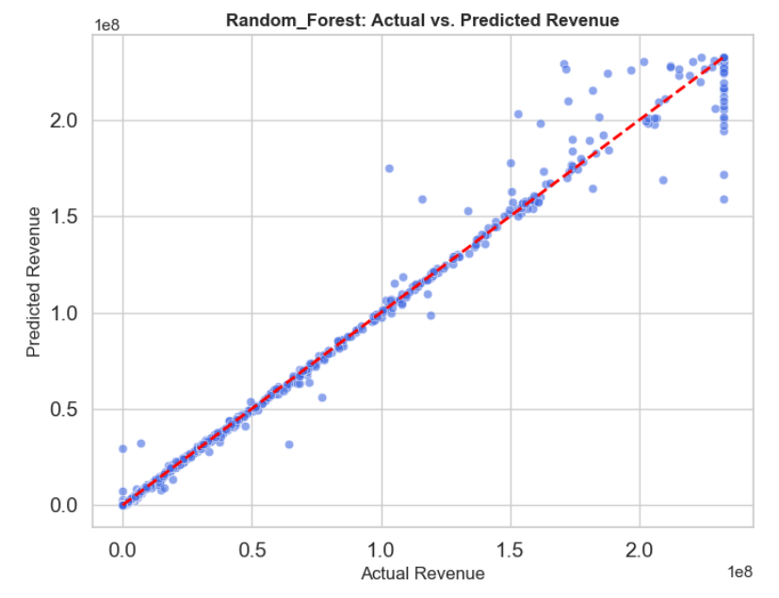
10. Predictive ml modelling for revenue predictions
Assess how accurately our model predicts movie revenue
Predicted revenues closely match actuals, showing strong accuracy.
Most points align with the ideal line, making it reliable for planning.

Slide 22
SUMMARY OF THE ANALYSIS
Top Genres: Comedy leads in total profit ($50.9B), followed by Action and Drama.
High ROI Genres: Documentaries, Drama, and Comedy deliver best returns for their cost.
Success Rate: Only 30% movies are top-performers but earn 24× more revenue.
Best Release Time: Summer (May–July) and December bring in most earnings.
Studios: Paramount leads in revenue ($26.6B). Small studios earned 56.5% of total profit.
Language Trends: English films earn 3× more than others while Japanese & Chinese top in non-English category.
Holiday Releases: Only 23% of movies, but still profitable.
Weekday Advantage: Weekday releases made 8× more than weekend ones.
Audience & Critic Trends: High revenue ≠ High ratings.
Revenue Prediction: Model predicts revenue with ±$2M accuracy.
Predicts movie rating categories with 70% accuracy, detecting low-rated films with 75% recall and strong overall balance.

Slide 23
CONCLUSION
Comedy, Action, and Drama drive the most profit, but low-budget genres like Horror and Documentary offer higher ROI.
Experienced directors and A-list actors consistently lead to higher revenue and ratings.
English films dominate, but Japanese and Chinese movies succeed in non-English markets.
Releasing in May, June, and December boosts both revenue and ratings—timing is crucial.
Smaller studios deliver more profit overall, showing that budget isn’t everything.
ML models like Random Forest help accurately predict revenue, aiding smarter investment decisions.

Slide 24
STRATEGIES AND SUGGESTIONS
Focus on Summer & Holiday Releases
Target May–June & December for maximum revenue.
Invest in High-ROI Genres
Prioritize Documentaries for cost-effective success if your budget is low.
Leverage Weekday Releases
Big-budget films can benefit from weekday openings.
Support Small Studios
Encourage indie content—they bring high profit share.
Boost Regional Language Content
Invest in Japanese & Chinese markets for non-English success.
Back Proven Directors & A-list Actors
High-grossing talent brings better returns.
Balance Ratings & Popularity
Aim for both quality and mass appeal to sustain success.
Use Predictive Models
Plan budgets and box office targets using ML predictions.

Slide 25
Thank you

